Slide 1




Conversation engine for deaf and dumb
Team 3 - Global externship - SmartInternz

Slide 2
Team Number : 03
Team Members:
Aymen Anwar
Dinu Andradi
Dulain
Habib Billah Samali Samaranayake Wishma Herath

Slide 3
01
02
Introduction
Model building
03
04
Flask application
Output

Slide 4
1.INTRODUCTION
A conversation engine for deaf and dumb people.
AI model that can identify the sign language images and map them into correct textual data.

Slide 5
Problem
According to the world health organization there are over 300 million deaf people around the world.
Even Though many technologies and equipment have emerged for their convenience, many of them still use sign language to communicate with other people.
Most of the normal people don't know how to communicate in sign language. This limits the communication between deaf and normal people.

Slide 6
Solution
A web application which have been built integrating an AI model that can capture a video feed of sign language and convert it into a voice.

Slide 7
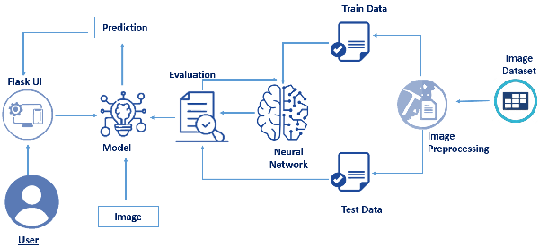
High-level architecture

Slide 8
2.Model building
Data set contains 9 classes of image from A to I

Slide 9
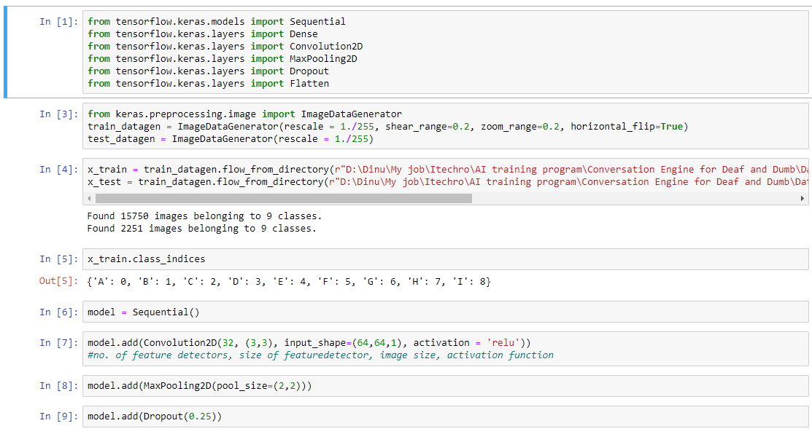

Slide 10
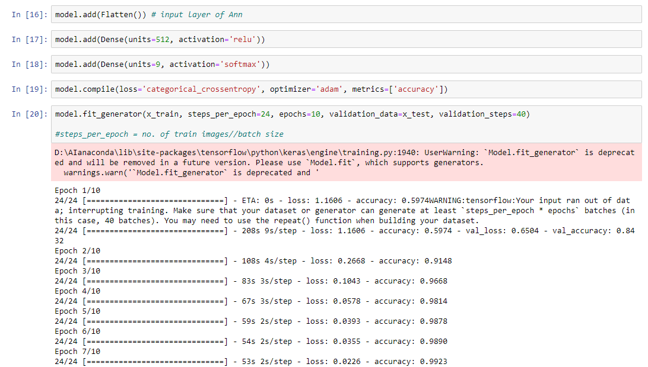

Slide 11
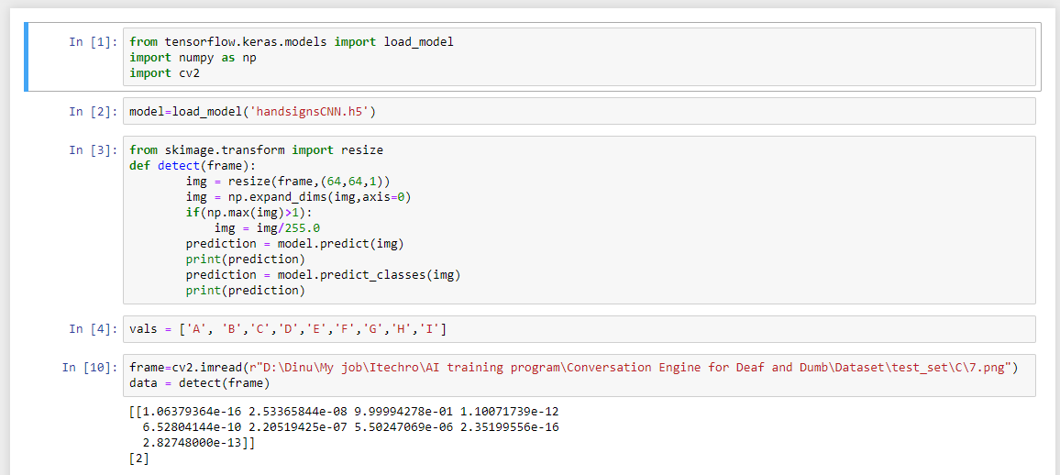

Slide 12
3.Flask application
Runs with python backend and html frontend

Slide 13
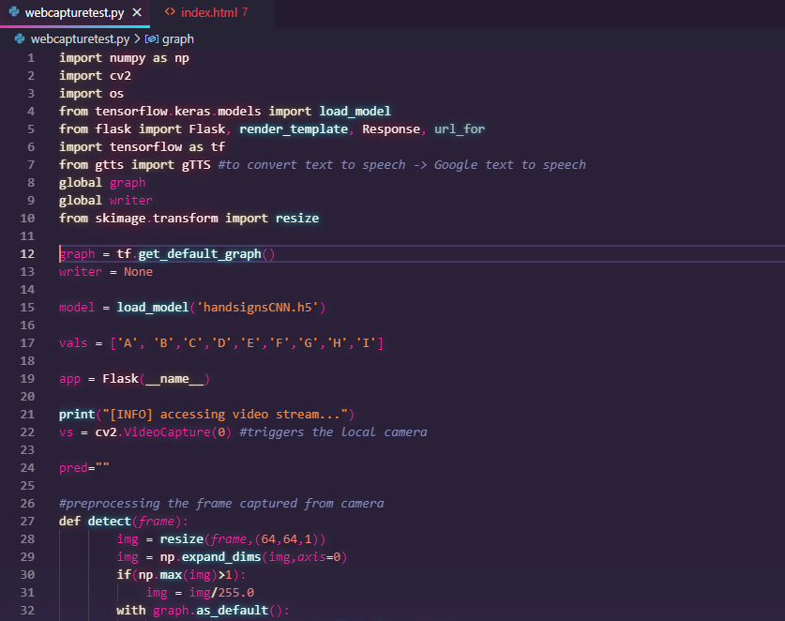

Slide 14
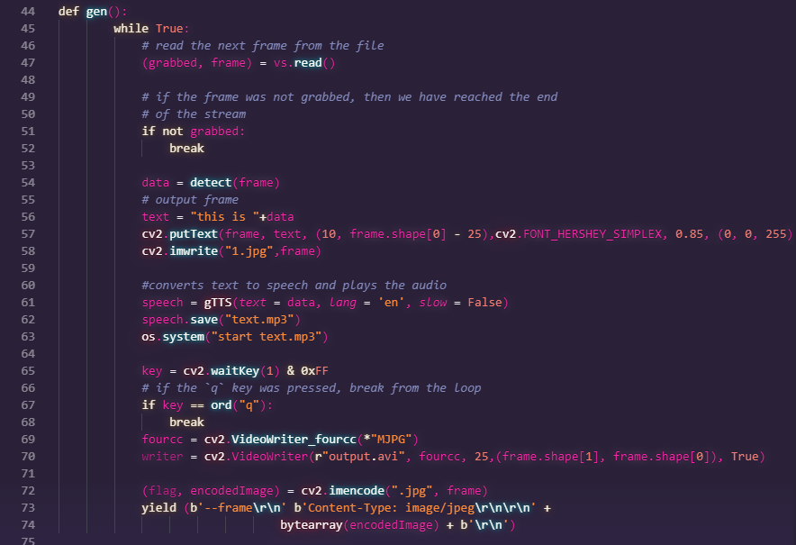

Slide 15
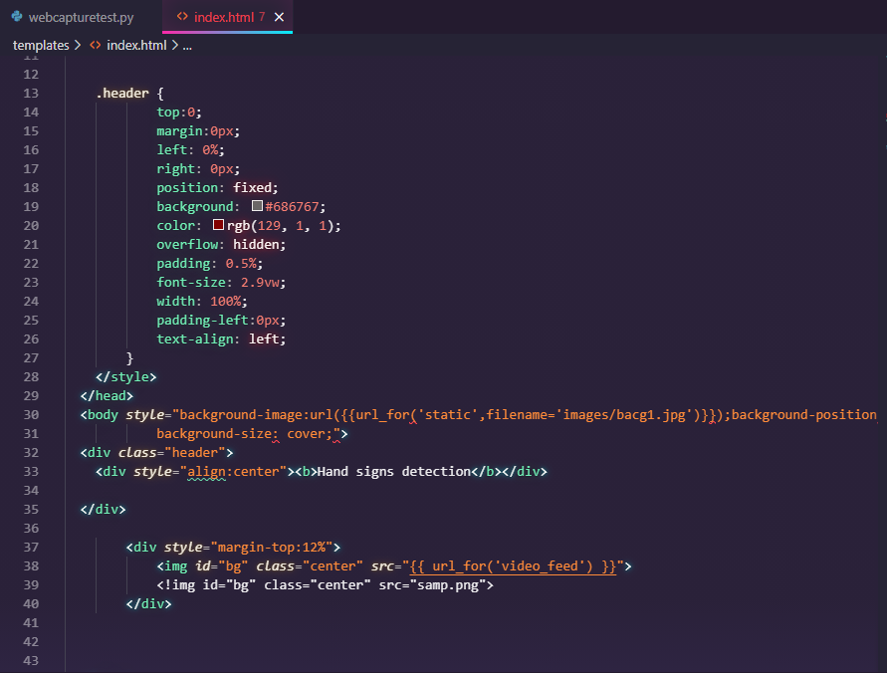

Slide 16
4.Output
User can open the application in the web browser by navigating to the port 5000 in the local host.
The video feed is captured through the webcam and the text and voice outputs are displayed accordingly.

Slide 17
Demonstration

Slide 18
Improvements
The web application can be developed to provide more controls and functionalities for the user.
Options to select time frames for video feed
To save text in proper written document format(phrases, paragraphs)

Slide 19
Self-reflection
Knowledge on CNN model building and practical scenarios of the model
Flask micro web framework.
Resolving issues and achieving the required goal.

Slide 20
Thank you

